Slide 1


M.Tech Program
Advanced Industry Integrated Programs
Jointly offered by University and LTI MindTree
Intelligent Cache Optimization for AI Agents
Review 3
DEV S SHAH
VIT CHENNAI
T9991
Knowledge partner | Implementation Partner

Slide 2
Intelligent Cache Optimization for AI Agents
Introduction
Problem
Repeated LLM queries cause high cost, latency, and token wastage
Scalability challenges due to growing API usage and rate limits
Solution: Intelligent Caching
Exact Match Cache : Redis
Semantic Similarity Cache : Pgvector
Context-Aware Retrieval : Agent/Tool support.
Intelligent Policy Engine: Cost/Frequency/Recency based eviction/caching.

Slide 3
Intelligent Cache Optimization for AI Agents
Objective
Tiered Cache Middleware: Multi-stage interceptor for LLM/Agent calls.
Intelligent Storage Layer:
  Exact: Redis for deterministic lookups (low latency).
  Semantic: Pgvector for context/meaning matches (prevents redundant compute).
Policy-Driven Optimization: Intelligent scorer evaluates if result worth caching (balances cost vs. memory).
Observability Suite: Streamlit dashboard tracking live hit-rates, latency, and cost savings.

Slide 4
Intelligent Cache Optimization for AI Agents
Module Name : ICO - cache
Core Application layer
Cache Implementation Layer
Intelligence layer
LLM provider layer
Support Components
Dashboard and Monitoring
Benchmarking FrameWork

Slide 5
Intelligent Cache Optimization for AI Agents
Problem Statement (Why ico-cache Graph is better)
1. Wasted cost & time — repeated or reworded queries re-run through the LLM, paying full token cost and 2–10s latency every time.
2. Unsafe caching — naïve semantic caches return false hits, causing cross-entity, cross-tenant, and cross-quarter answer bleed.
3. No production-ready solution — existing caches are either exact-match only, infra-heavy, platform-fragile, or not context-aware.
4. No visibility into savings — teams can't measure how many LLM calls, tokens, and dollars a cache actually eliminates.

Slide 6
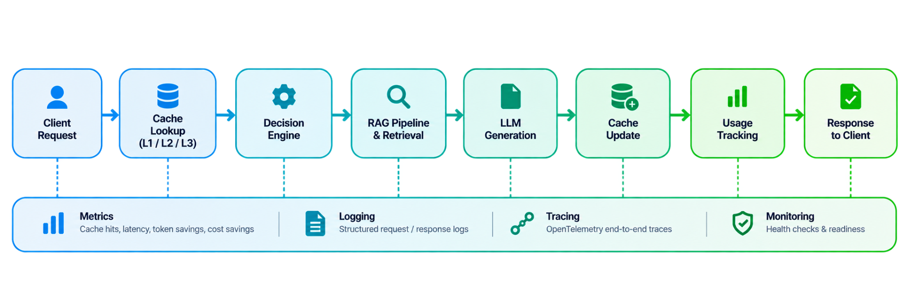
Intelligent Cache Optimization for AI Agents
Methodology

Slide 7
Project Intelligent Cache Optimization for AI Agents
- Calibri body 18
Approach/Algorithms/Tools
Area | Approach / Algorithm | Tool Used
L1 Exact cache | SHA-256 hash of normalized query + model + prompt_version + metadata | Redis / SQLite
L2/L3 Semantic, Context aware cache | FastEmbed vectors (384-dim) + cosine similarity ≥0.85/0.90, dual-vector for context | Qdrant / LanceDB, BAAI/bge-small-en-v1.5
Anti-false-hit guard | Metadata hard-gate on tenant/entity/quarter/model; mismatch = block | metadata_guard.py + decision_engine.py
Document ingestion | Content-sniffing + chunking + OCR fallback | PyMuPDF, beautifulsoup4, tree-sitter, Tesseract
Concurrency + tenancy | Single-flight coalescing, tenant_id isolation | asyncio, Redis, Qdrant collections
Observability + QA | Metrics/tracing/cost accounting, deterministic benchmarks | Prometheus, OpenTelemetry, pytest, benchmark.py

Slide 8
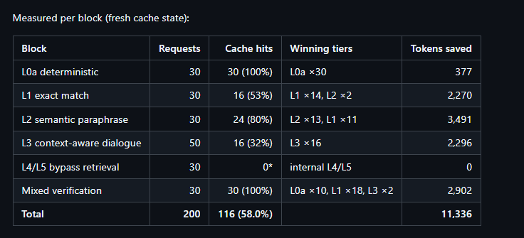
Intelligent Cache Optimization for AI Agents
Findings and Results

Slide 9
Intelligent Cache Optimization for AI Agents
Title - Calibri body 18
Conclusion… Calibri body -36
Achievements
Developed an end-to-end system that converts SEC filings into a queryable financial knowledge graph
Delivered accurate answers with source citations and zero hallucinated financial figures
Ensured strict company isolation — no cross-company data mixing in results
Future Work
Build graph segments on-the-fly during query time instead of pre-loading all filings
Auto-process new filings daily so the system stays up-to-date without manual runs
Reduce storage and startup time by loading only the data each query needs

Slide 10
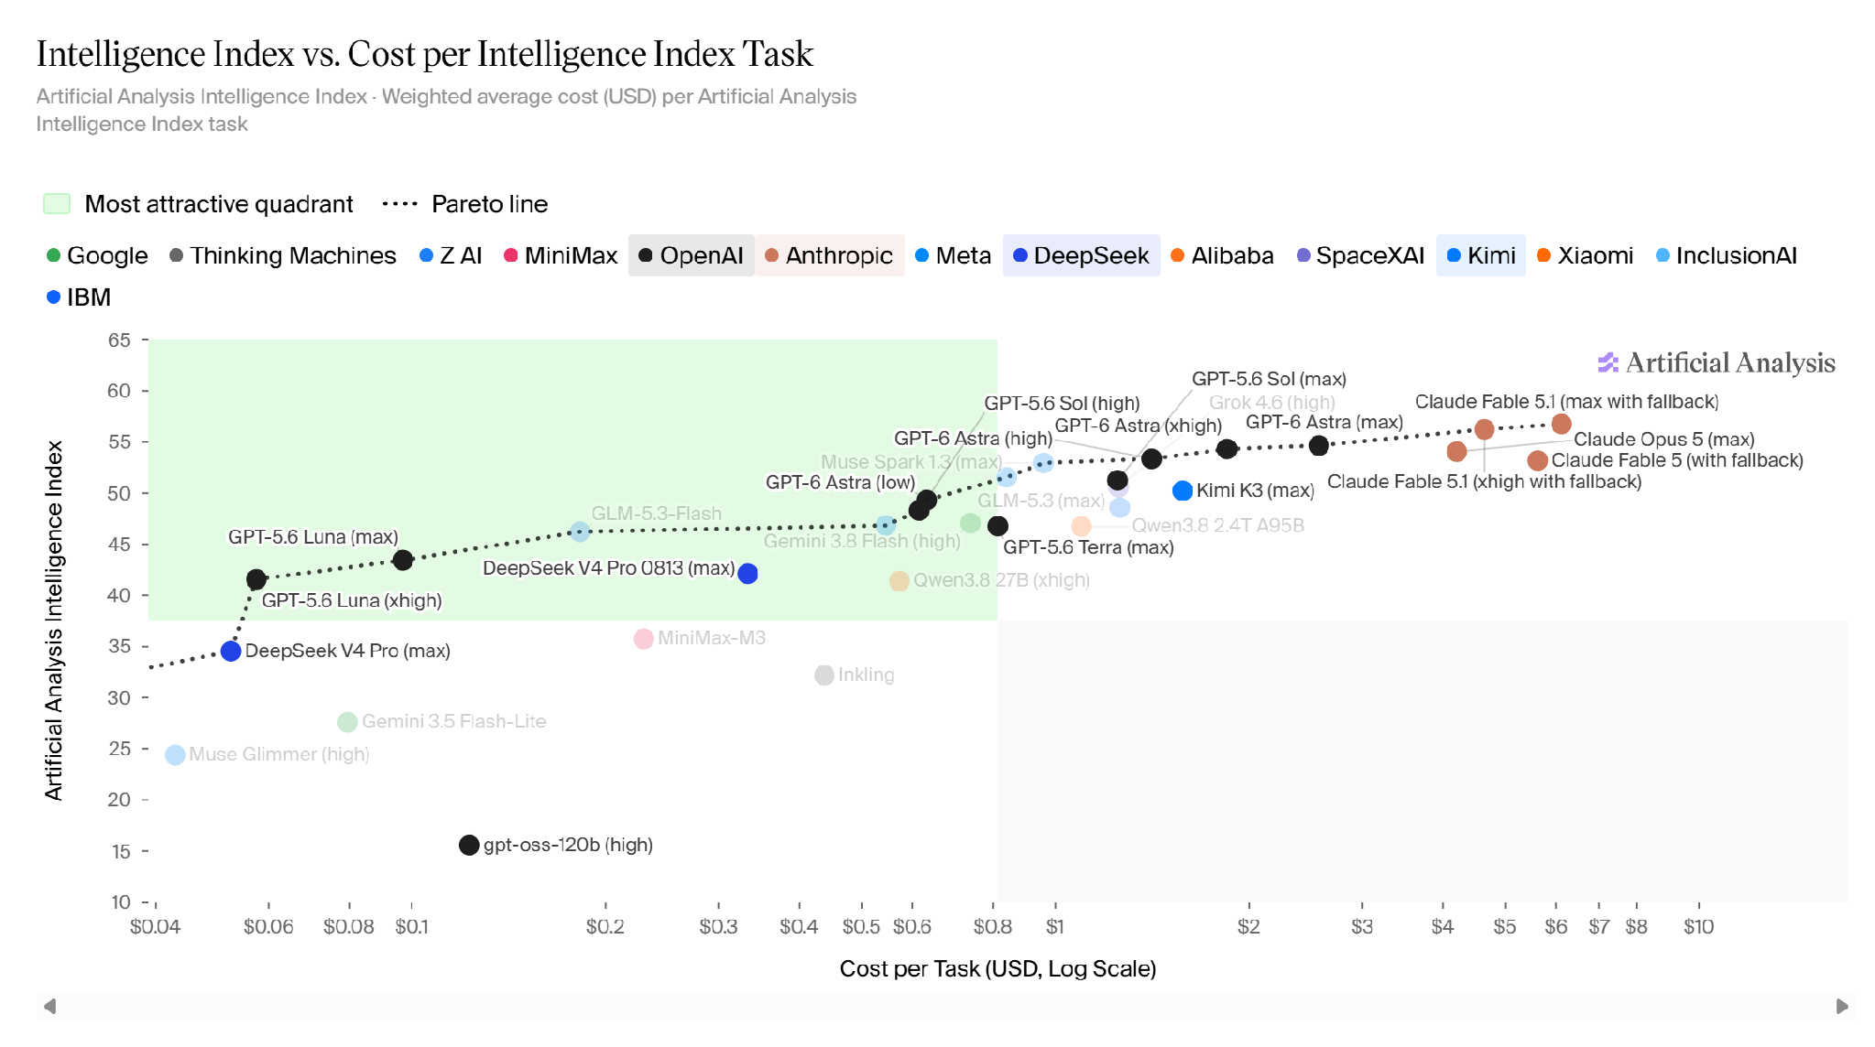
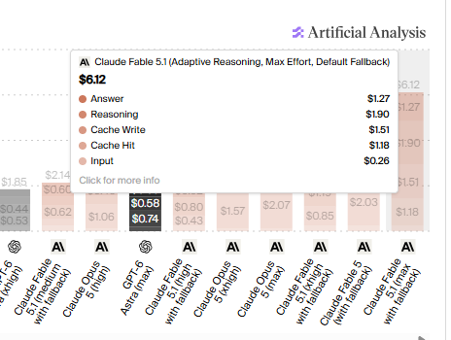
Intelligent Cache Optimization for AI Agents
Refrenences

